Slide 1
Digital content

Slide 2
How to make digital content?
Make clear content
Using zoom recording video
Take 5mn to make a video
Make clear voice

Slide 3
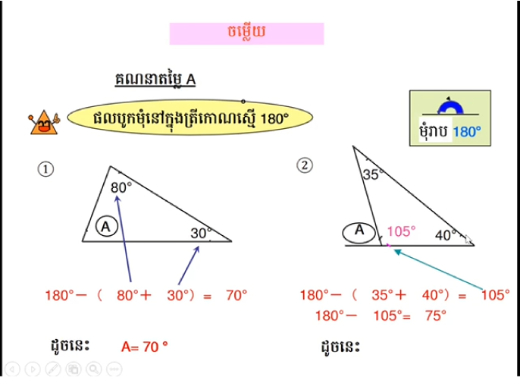

Slide 4
Benefit of digital content
01
Blended learning classroom
02
Flexibility learning
03
Student engaging

Slide 5
Thank you

