Slide 1
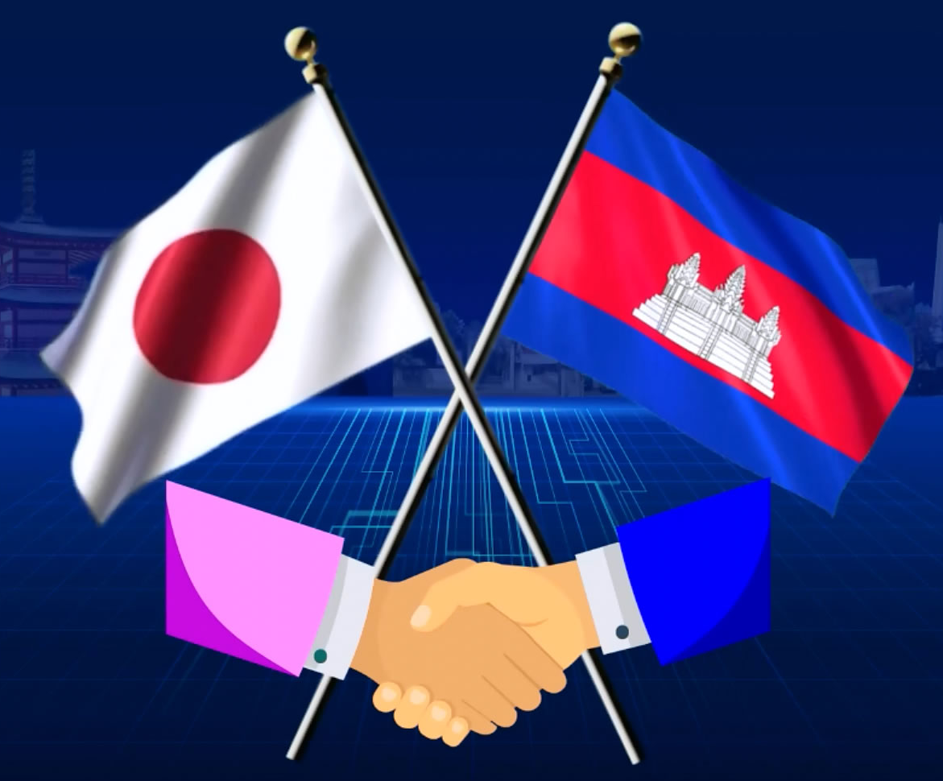
សកម្មភាពសំខាន់ៗនៃដំណើរទស្សនកិច្ចនៅប្រទេសជប៉ុន What I have learnt during study tour in Japan
5-10 September 2022
បង្ហាញដោយ៖​ លោក ថន សុធារ៉ា គ្រូឧទ្ទេសសាលាគរុកោសល្យ និងវិក្រឹតការខេត្តសៀមរាប
Presented by: Thon Sotheara from PTTC-SR

Slide 3
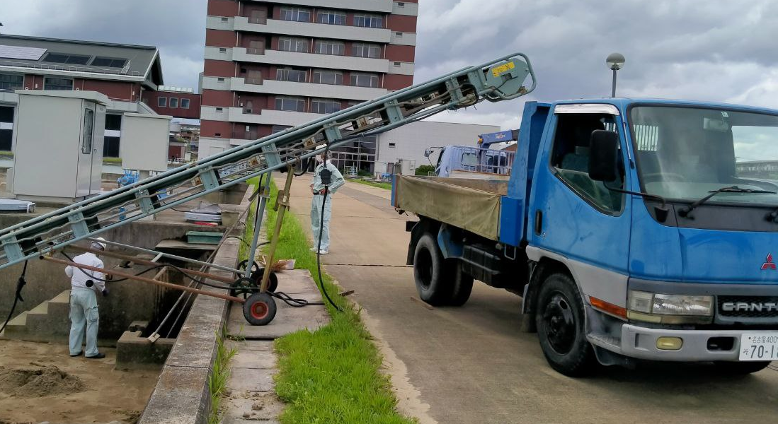
Water Purification Plant Facilities-WPP
Notes:
មណ្ឌលបន្សុតទឹកស្អាតនៅ ណាហ្គោយ៉ា។ ជាកន្លែងចម្រោះទឹកស្អាត

Slide 4
Toyota Commemorative Museum of Industry and Technology
Started in 1906 by Sakichi Toyoda
Invented Steam Engine
Metal working
Innovating automobile, modern sewing machine and robot
Now TOYOTA group available around the world

Slide 5
The Virtual Reality-VR

Slide 6
Science Museum in Nagoya City

Slide 7
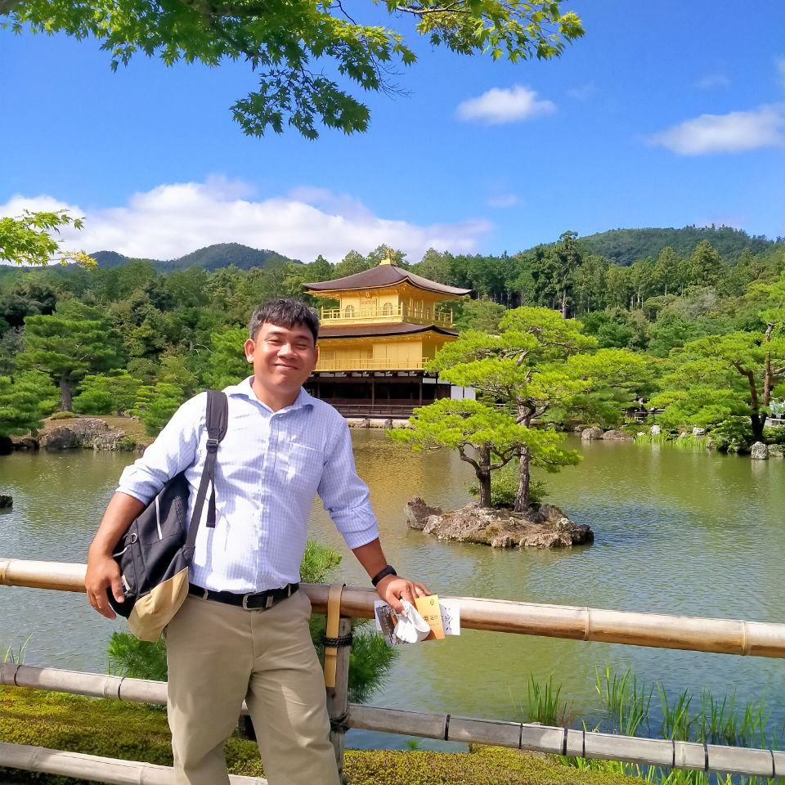
Others sight-seeing pictures

Slide 8
What have we learnt from these activities?

Slide 9
ការអភិវឌ្ឍទាំងឡាយកើតចេញពីការសិក្សាស្រាវជ្រាវ និងការខិតខំប្រឹងប្រែងលើការងារនោះ
WPP
Toyata Mosuem
VR
Cambodia should learn more about water filter for rural area
We can use our Mekong river for making purify water for decreasing water price and provide quality water for all people
Japan is a good country about water facilities
We will use what we have learnt to share to friend in Cambodia about drinkable water
Toyata develop itself to be upgrade from Circular Loom to invented any modern materials.
Cambodia must be find new technology to make better community.
We learnt that Japanese people worked so hard and they get back the quality of life and beneficiary.
Technology is very important in teaching context.
Virtual Reality is very useful object in learning.
We can apply VR in teaching to promote our teaching and ICT skills.
I hope Cambodia study class will have more devices to serve for education.

Slide 10
Link to search for more info:
WPP: https://www.water.city.nagoya.jp/file/35764.pdf
Toyota Commemorative Museum: https://www.tcmit.org/english/
Nagoya City Science Museum: http://www.ncsm.city.nagoya.jp/en/

