Slide 1
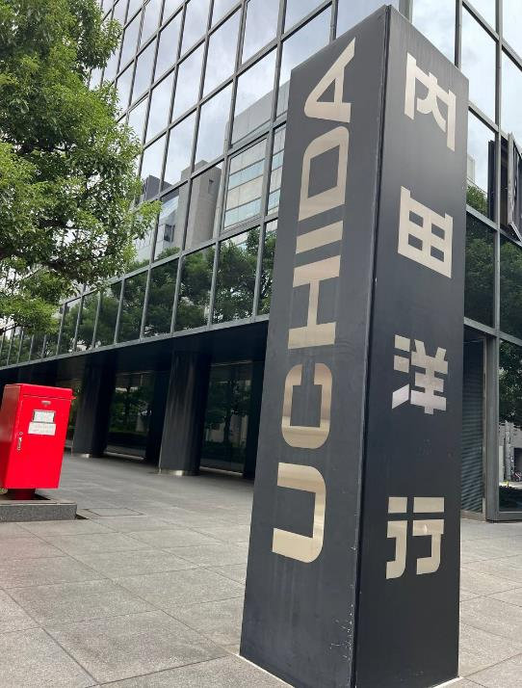
Future classroom
Located in Chou,Osaka-Izumimachi.
UCHIDA started in 1910.
The Main Building was builded in Tokyo in 2000.

Slide 2
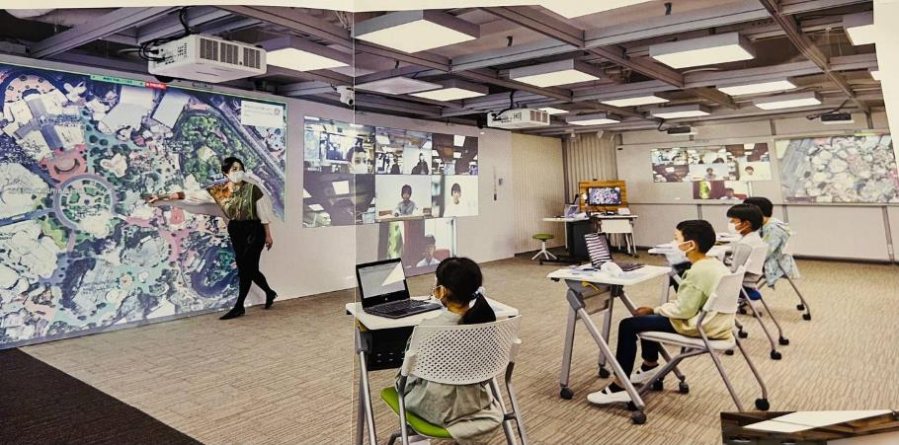
The big wide screen is about 9m.
Set up 4 projectors and 2 smart microphone speakers.
Movable smart tables and chairs.
On the right side there is a big wide screen and also a white bord.
Using for Meeting or Semina with other people from the other side.
With the same stucture of Future Classroom, Teacher or Other person can Control the light on/off through online.
Connect to the real word

Slide 3
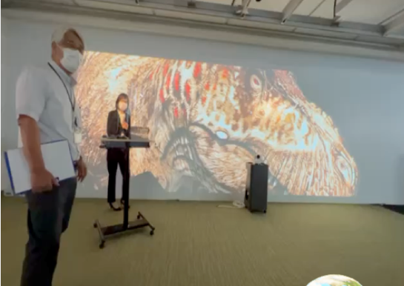

Slide 4
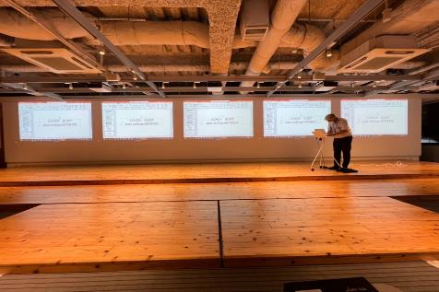
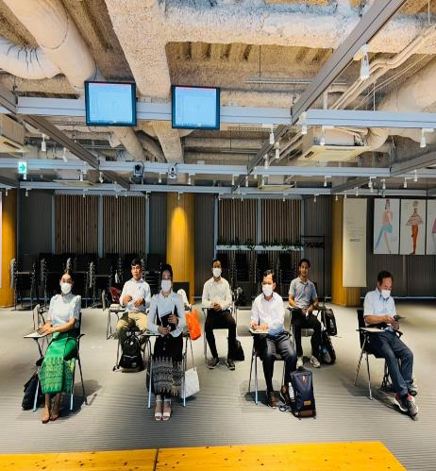
GIGA Scool Program
Ensure `1 devise for 1 student with a high-speed network in school` which bring optimized and creative learning to all students who will live in the Society 5.0.
One Minute
Presentation
Fact
Question
Opinion

