Slide 1
Cambodia Teacher Training College & Phnom penh Teacher Education College
Virtual Reality in Education
September 5 – 11, 2022 Nihon Fukushi University

Slide 2
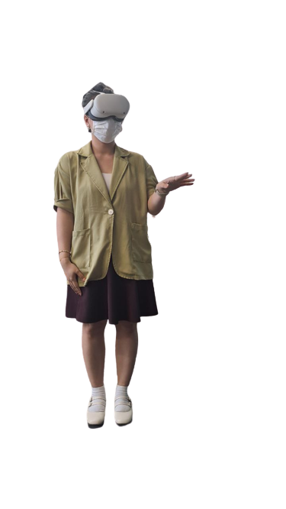
What is virtual reality learning?
Notes:
Virtual reality, or VR, is taking off in education with an increasing number of schools adopting the technology.
VR allows students to experience destinations from across the world without ever having to leave the classroom.
Imagine students being able to explore the pyramids of giza whilst sat at their desks.
This is what virtual reality education allows.
Most people have heard of virtual reality (VR) but many people do not know what it is or how it is used in learning and education.
VR refers to interactive content (images or videos) which enables the viewer to explore the entire 360 degrees of a scene.

Slide 3
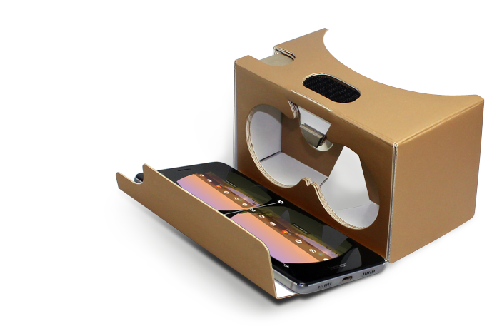
How does it work?
Notes:
A type of VR known as 360VR is most commonly used in education.
With this type of VR, real-world locations are captured with specialist cameras and equipment.
The footage is then taken back to the studio where it is produced into VR content.
The VR content can then be viewed on VR headsets or projected onto walls in what are known as immersive classrooms.
360VR can be used in education to teach pupils about the world around them.
What’s more, virtual reality has a unique ability to inspire and engage students.
Students can experience locations that would not be possible or too expensive to visit in person.
In this way, VR can open a whole new world of possibilities to teachers and schools.

Slide 4
How can virtual reality improve education?
Given the growth of VR within education, and the positive response from schools, we wouldn’t be surprised if VR made it onto the curriculum at some point in the future. Curriculum aligned content and structured VR Lesson plan have already been developed.

Slide 5
How can virtual reality improve education?
Virtual reality can improve education by providing students with memorable and immersive experiences that would otherwise not be possible. What’s more, it can all take place within the classroom.
VR is accessible to every student and can be easily monitored by teachers. Virtual experiences have the power to engage and inspire students in a unique and powerful way.

Slide 6
How can virtual reality help students?
Students learn better through experience
VR has the ability to inspire
VR sparks the imagination and encourages creative thinking
VR in education promotes peer interaction

Slide 7
How can virtual reality help students?
VR engages students
VR provides realistic travel experiences
VR in the classroom is inclusive
VR offers memorable educational experiences

Slide 8
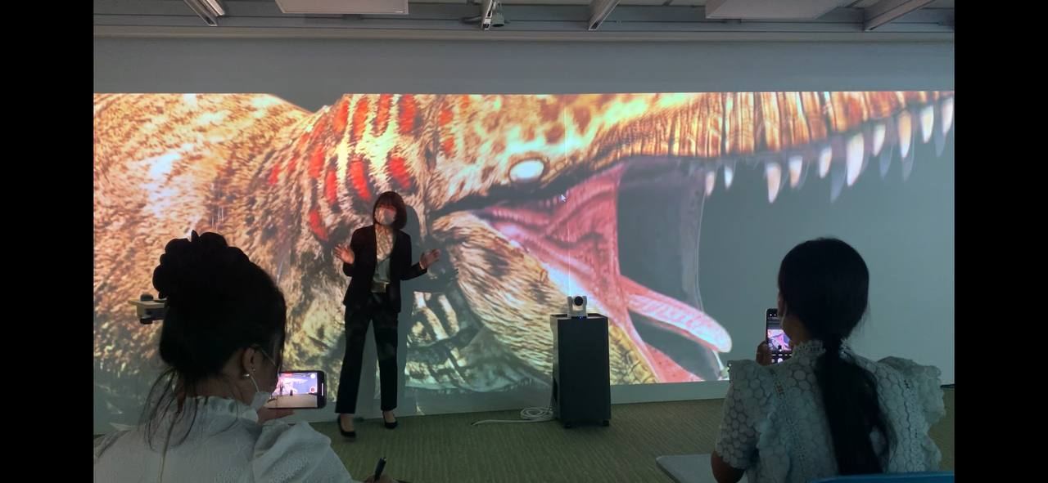
VR is a future leaning in Cambodia
With the help of virtual reality, the quality of learning will improve a lot.
Practical learning is always better than the academic knowledge.
With VR, we can learn from experts. Concepts like a virtual library and Digital Contents are already developing with a various type of subject in Japan (Future Classroom).
I hope in the nearly futuer Cambodia will have this technology soon to accelerate the education sector.

