Slide 2
Water Supply Facilities
ស្ថានីយទឹកស្អាត
by Chhom Phira (PTTCSR)

Slide 3
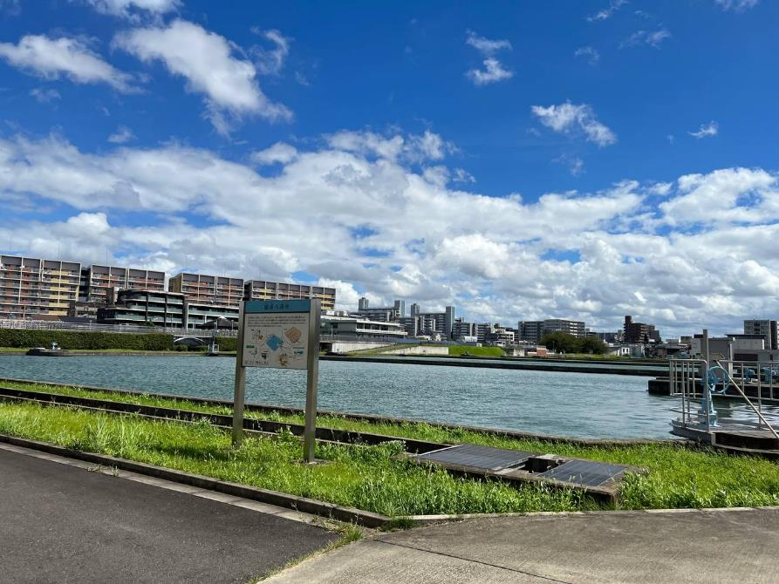
Nabeya-Ueno Water Filtration Plant (WPP)
Began in 1910 , completed 1914
Now ! Area sites : 137,325 m²
(bigger than PTTCSR: 58007 m² )
Slow & rapid sand filtration system
Well-known : Slow sand filtration system
ល្បីឈ្មោះ ប្រើប្រព័ន្ធចម្រោះដីខ្សាច់
Produce 290,000 m³ /day
for 50000 peoples, the city of Nagoya

Slide 4
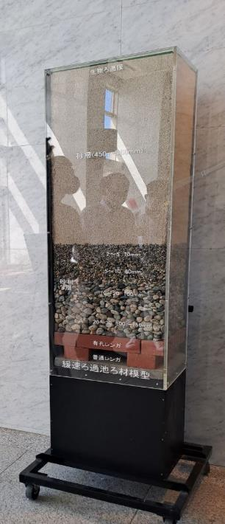
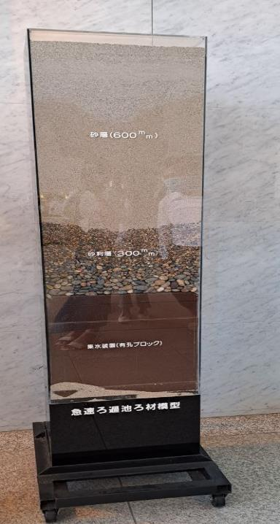
Slow Sand Filtration System
Rapid Sand Filtration System
ខ្សាច់ Sand layer 60cm
ខ្សាច់ Sand layer 90cm
ដុំគ្រួស gravel layer 30 cm
ដុំគ្រួស gravel layer 35cm
slow, 12 hours process
1m³
Faster, less than 2 hours process: 1m³

Slide 5
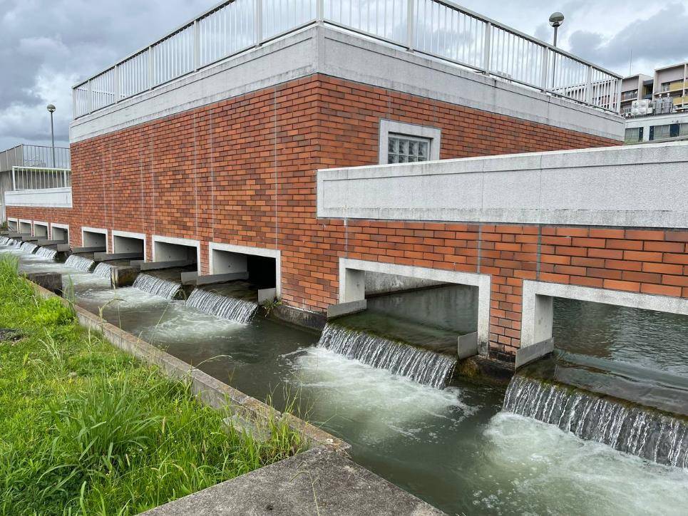
Why is slow filtration system important?
Automatic process​(water force)
ដំណើរការស្វ័យប្រវត្តិ (ប្រើកំលាំងទឹក)
Ex.
Raw Water from Kiso river
Distance : 23 km, 25 meters height
Using pipes for water flow

Slide 6
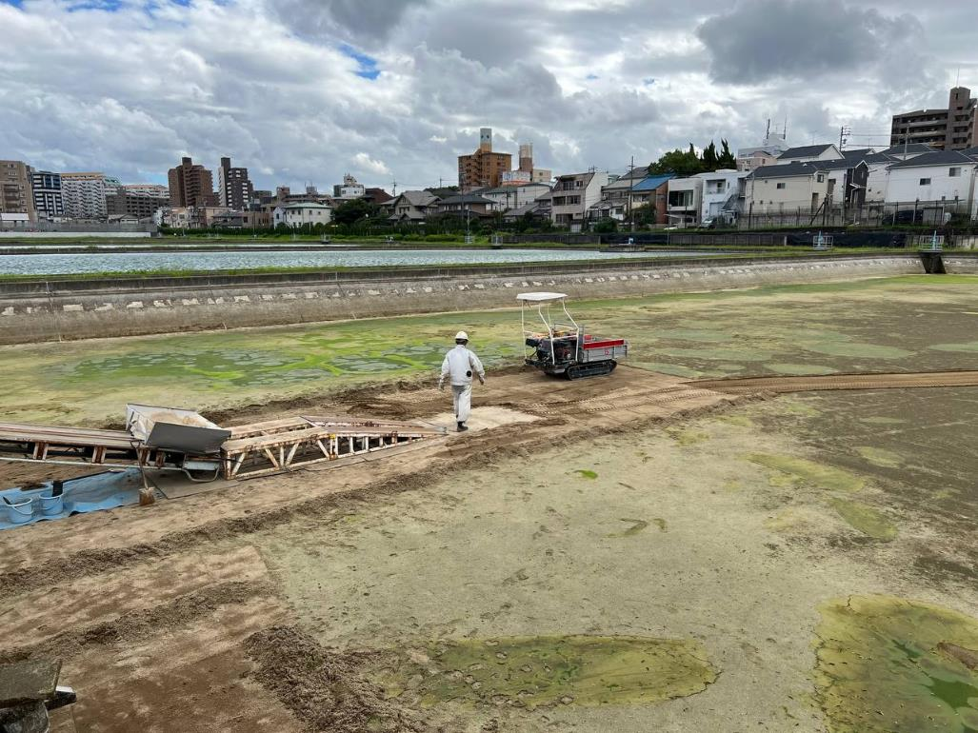
Successful experiences
បទពិសោធន៍ ជោគជ័យ
Technology for
Ex. water control
sand cleaning
remove wastes from the water
water storage
water supply

Slide 7
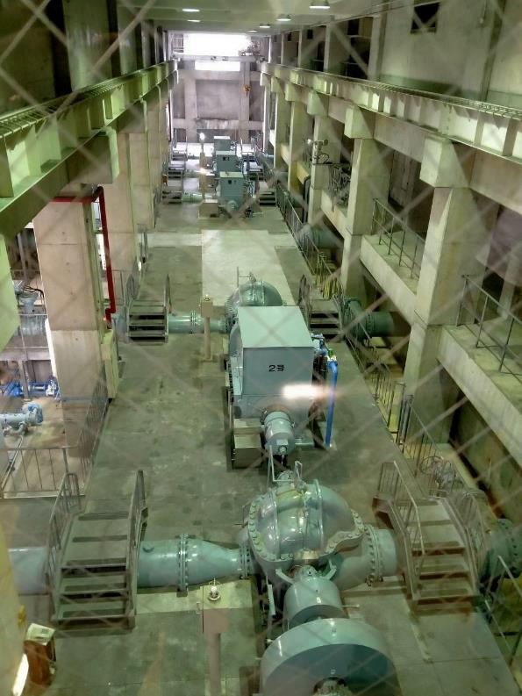
Messages of water conservation
ការថែរក្សា ប្រភពទឹក
water is recycle
Take care of the rivers, lakes, etc.!
Drink healthy water !
ផឹកទឹកស្អាត

Slide 8
Slow filtration system is useful for Cambodia
Government should think of “this model”:
people have clean water to drink
help to reduce the poverty “ illness”
We start first: ចាប់ផ្តើមពីយើង
Do not pollute the water “Tonle Sap Lake, Mekong river, Siem Reap river…” កុំធ្វើឲ្យទឹកកខ្វក់

Slide 9
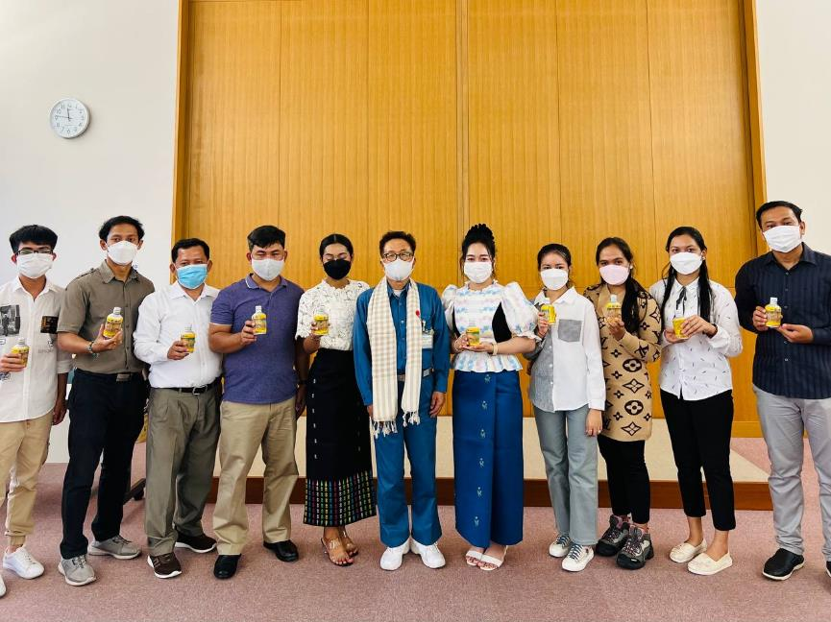
Clean water from quick & slow sand filtration system are very useful for our life !
Within technology, production of quality of water supply is increasing.
Nabeya-Ueno is very good “ model” to the world, particularly Cambodia

